Slide 1
Kenya Baseline Transmission Model

Slide 2
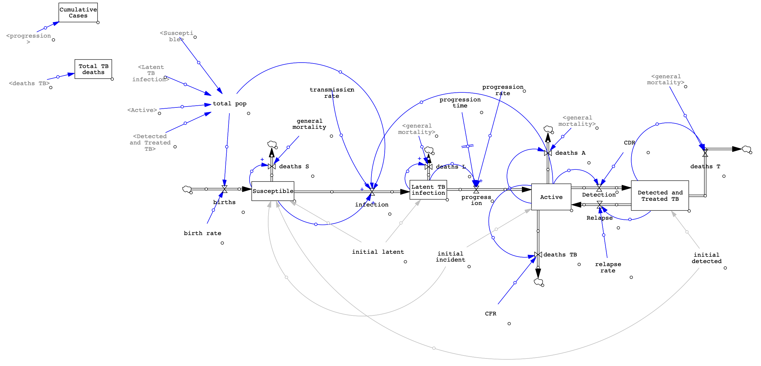
Baseline SFD

Slide 3
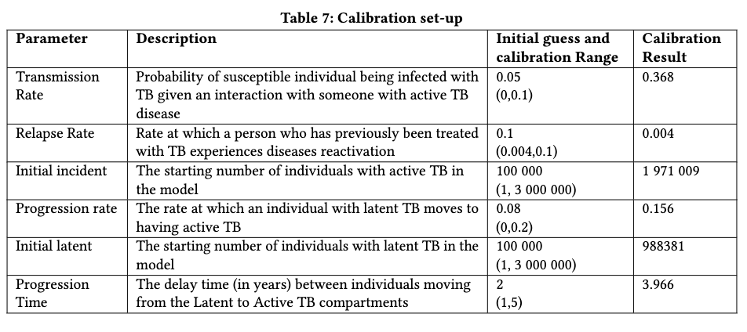
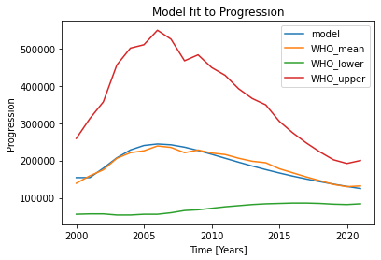
Baseline Calibration

Slide 4
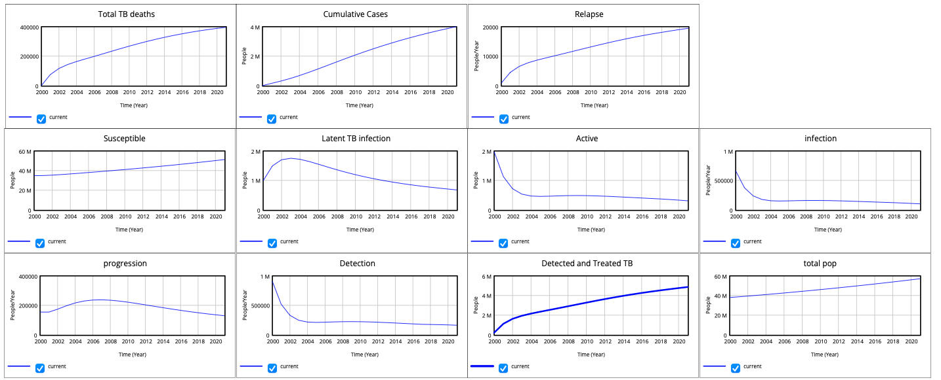
Calibrated Baseline Output

Slide 5
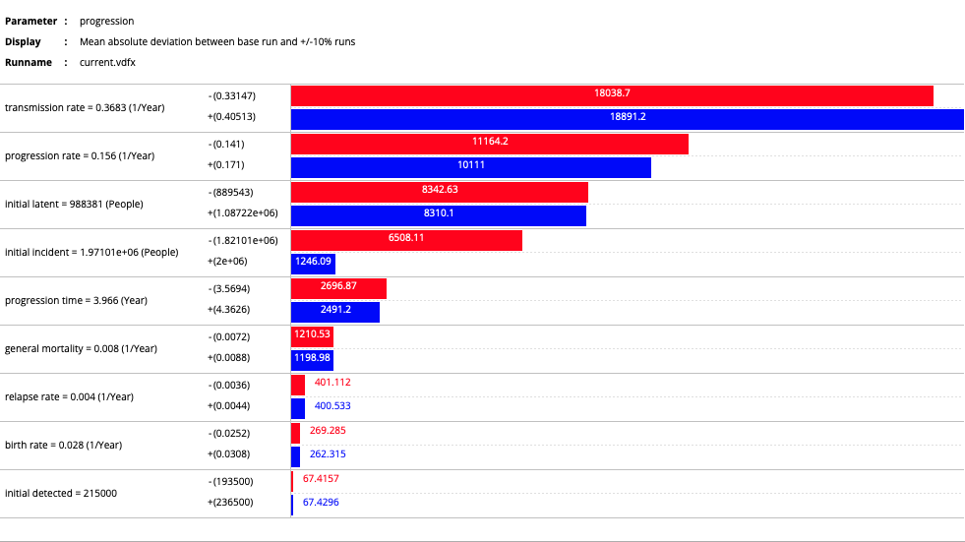
Tornado Plots: Progression

Slide 6
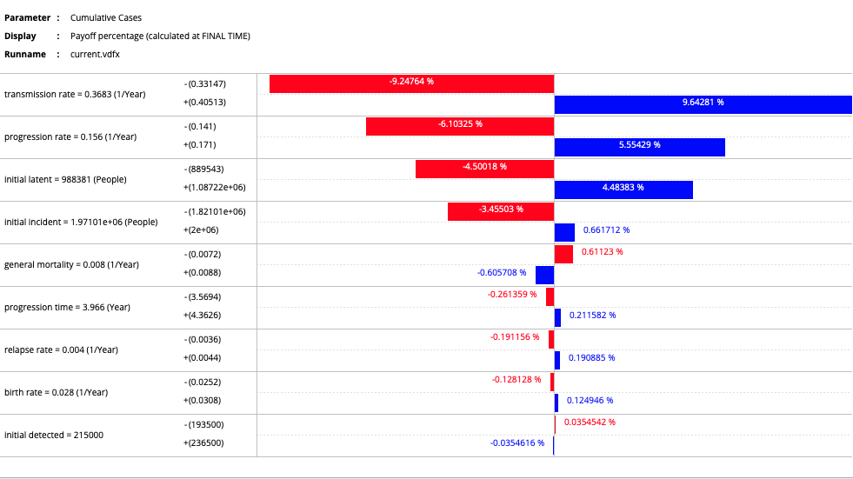
Tornado Plots: Cumulative New Cases

Slide 7
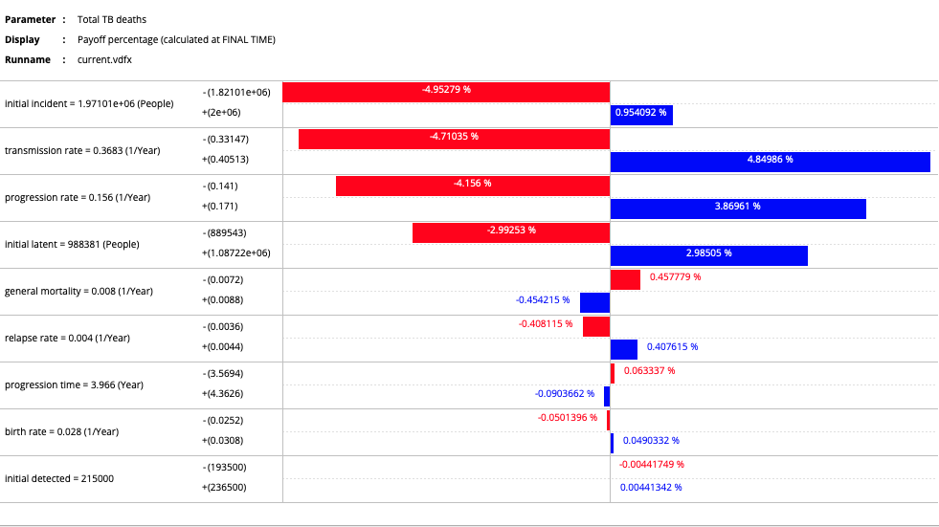
Tornado Plots: Total TB deaths

